Slide 1

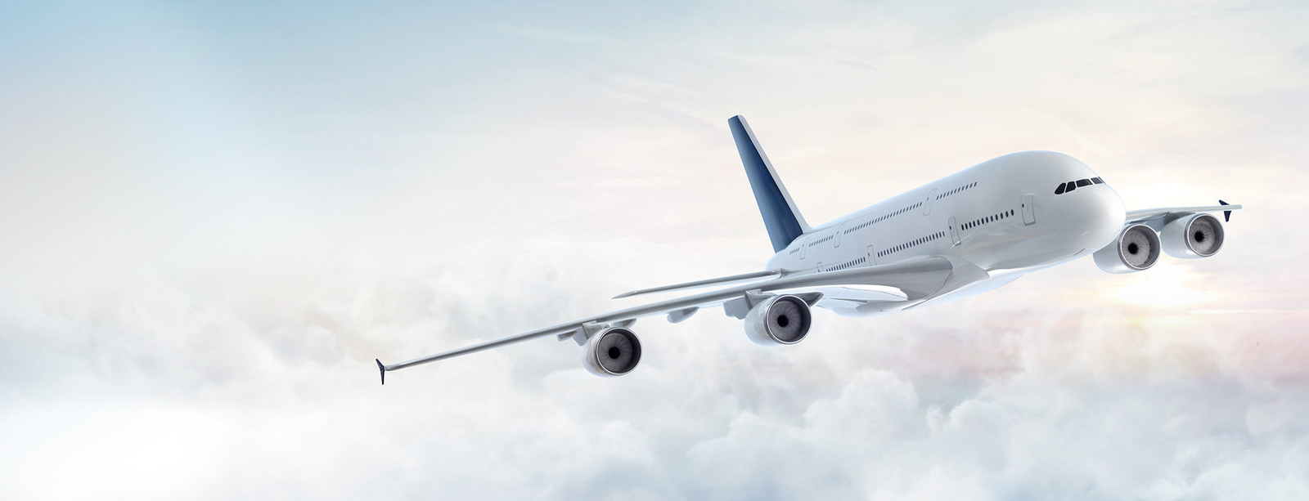
Monetization and Scraping in the Airline industry
How Online Travel Agents and Airlines make money and control scrapers
Muthuraja Palaniappan

Slide 2
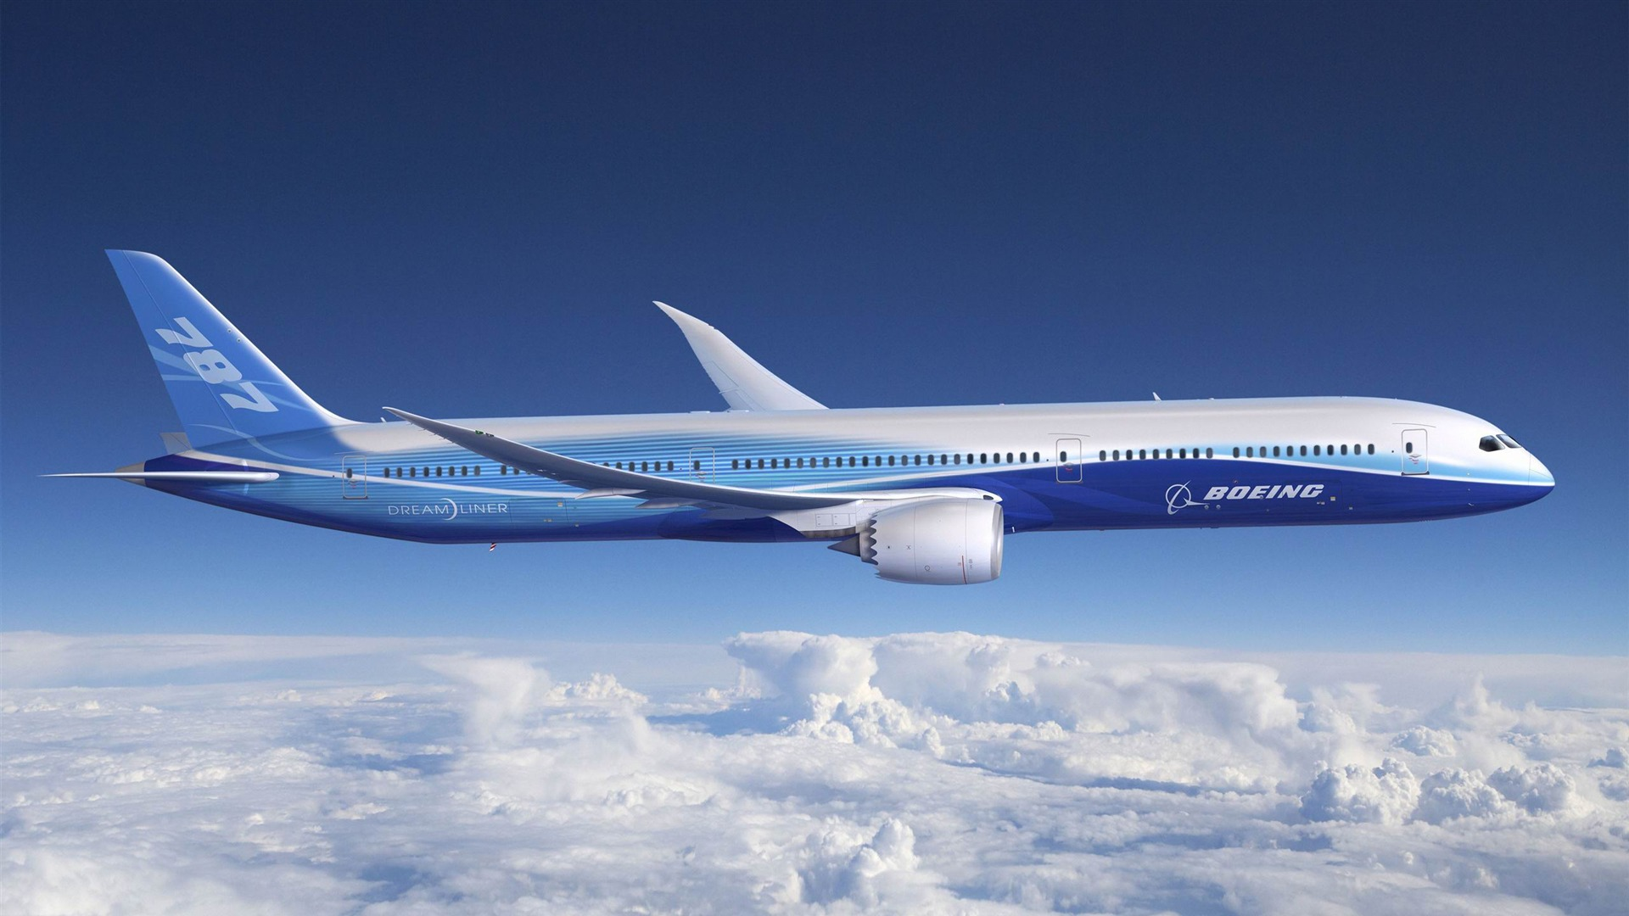
Topic and relevancy
Understand how online travel agents monetize and how airlines prevent scraping
Publicly available data – so what’s wrong in scraping?
Risk of going against Terms of Service
Unauthorized access – though it is publicly available data
How the industry makes money
Direct sales on Airline website
Sell through Global Distribution System (GDS) like Sabre
Loyalty programs
Direct mails
Ancillary revenues
Airline Tariff Publishing Company (ATPCO)
All fare details and availability are loaded to ATPCO
Online Travel Agents (OTAs) and other agents buy and sell from GDS
Earn commission
Ancillary revenues
Loss leader strategy
https://www.atpco.net/

Slide 3
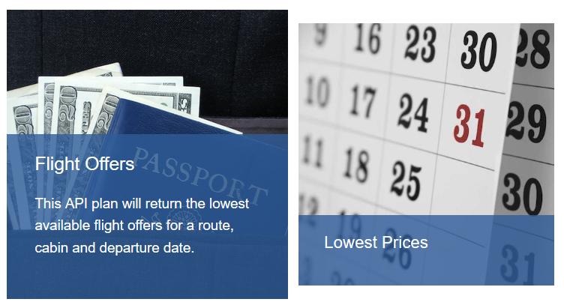
Do the Airlines need to scrape
All competitors’ current fare details available to all participating airlines from Airline Tariff Publishing Company (ATPCO)
So Airlines need not scrape
Case study: SkyScanner
All Airlines and Online Travel Agents (OTAs) have their APIs exposed to interested parties
SkyScanner uses all these APIs and data from Global Distribution System (GDS)
SkyScanner has its own API too
Net result: no scraping done by any company

Slide 4
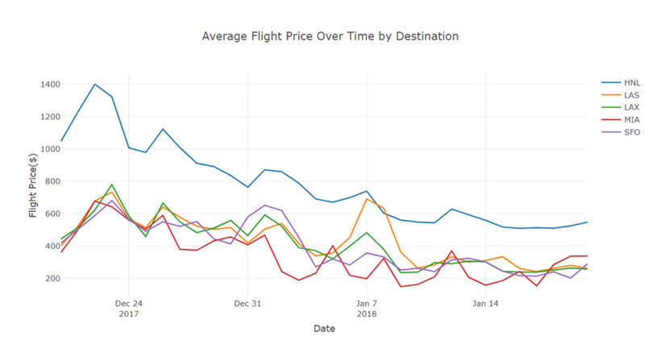

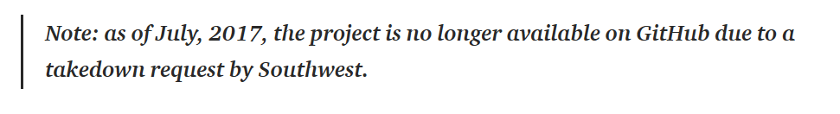
Where the scrapers come into the picture
Southwest Airlines – no change fee if you re-book when price changes
Price Tracking websites – sending automated alarms to users
No way to earn ancillary revenues
Python for scraping, Selenium for dynamic pages, Tesseract for CAPTCHAs
Multiple readymade tools like Octoparse, Promptcloud
Node Osmosis used by Hacker Zeke Gabrielse
Student project by scraping from TripAdvisor

Slide 5
Checks and balances
Excessive load on the servers
Poor look-to-book ratio
CAPTCHAs irritate genuine customers and does not deter scrapers
Block IP; Nothing works like lawsuit does
How Hopper works
Predict when the price will fall
Data collected from Sabre GDS
10 – 15% savings for customer with 90% accuracy
Earn from commissions

Slide 6
Implications: $45 profit and a legal suit!
SWMonkey : Comparison of Southwest prices to alert customers
$3 fee for each saving made – is this a sustainable business?
Made profits of $45 and faced a ‘cease and desist’ letter from Southwest
In the near future
All the above doesn’t deter programmers who scrape for personal use
But the moment you make a business out of it, you are in trouble
In the near future, this might continue before Airlines figure out ways to stop this

